Slide 1
Library-Computer-Usage-Analysis
Brown Biggers • Michael Ellis Nickolas Lloyd • Patricia Tanzer

Slide 2
Overall goals:
What criteria lead to the best placement of public access machines in the library?
What effect, if any, do changes in configuration, location, and outside elements have on usage?
Can a better solution be derived from analysis of data and machine learning?

Slide 3
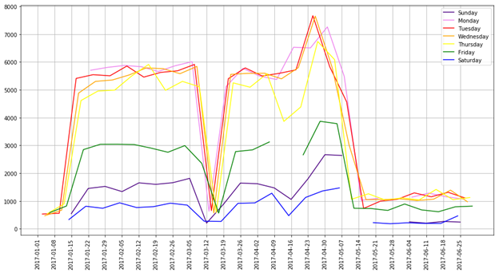
Gate Counts with Semester Schedule
01/17/17, Tues: Classes begin
03/11/17, Sat: Spring Break begins
03/20/17, Mon: Spring Break ends
04/14/2017, Fri: Holiday
05/03/17, Wed: Reading Day
05/04/17, Thurs: Finals start
05/12/17, Fri: Commencement

Slide 4
Decoding the weather
('METAR: ', 'METAR KEWR 111851Z VRB03G19KT 2SM R04R/3000VP6000FT TSRA BR
FEW015 BKN040CB BKN065 OVC200 22/22 A2987 RMK AO2 PK WND 29028/1817 WSHFT
1812 TSB05RAB22 SLP114 FRQ LTGICCCCG TS OHD AND NW-N-E MOV NE P0013 T02270215’)
-----------------------------------------------------------------------
station: KEWR
type: routine report, cycle 19 (automatic report)
time: Wed Oct 11 18:51:00 2017
temperature: 22.7 C dew point: 21.5 C
wind: variable at 3 knots, gusting to 19 knots
wind: WNW at 28 knots at 18:17
visibility: 2 miles
visual range: on runway 04R, from 3000 to greater than 6000 meters
pressure: 1011.5 mb
precipitation: 0.13in
weather: thunderstorm with rain; mist
sky: -a few clouds at 1500 feet
-broken cumulonimbus at 4000 feet
-broken clouds at 6500 feet
-overcast at 20000 feet
remarks: - Automated station (type 2)
- peak wind 28kt from 290 degrees at 18:17
- wind shift at 18:12
- frequent lightning (intracloud,cloud-to-cloud,cloud-to-ground)
- thunderstorm overhead and NW-N-E moving NE

Slide 5
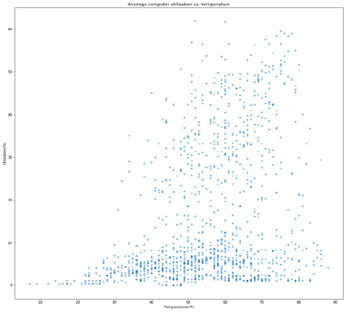
Avg Computer Use vs Temp One semester of data

Slide 6
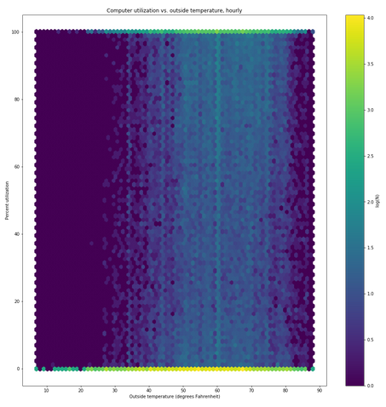
Use vs. temp per machine One semester of data

Slide 7
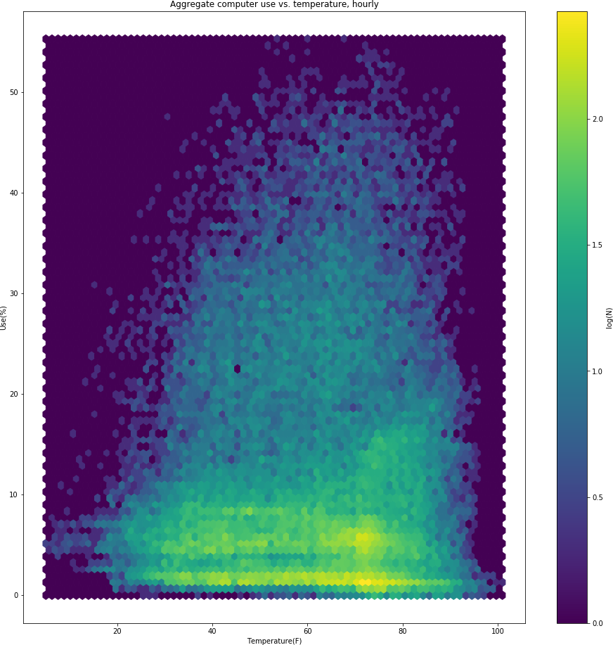
Avg Computer Use vs Temp Seven years of data

Slide 8
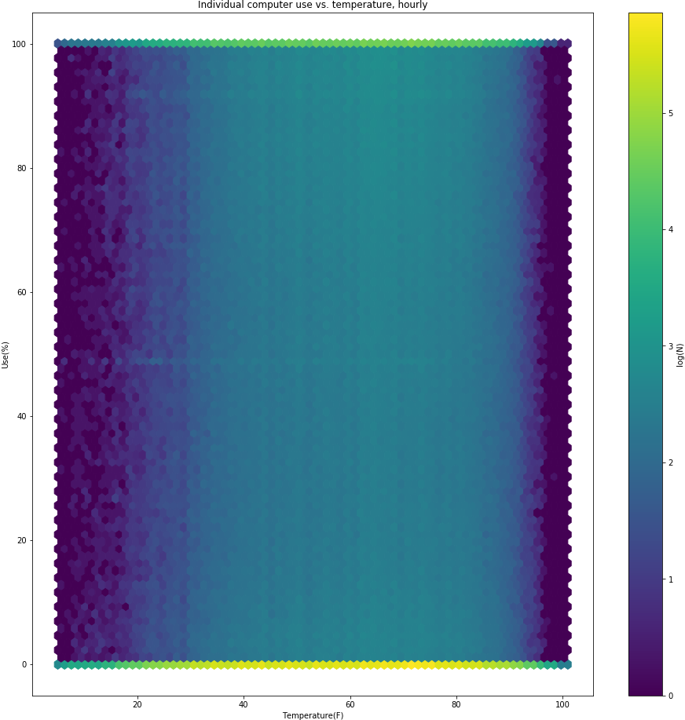
Use vs. temp per machine Seven years of data

Slide 9
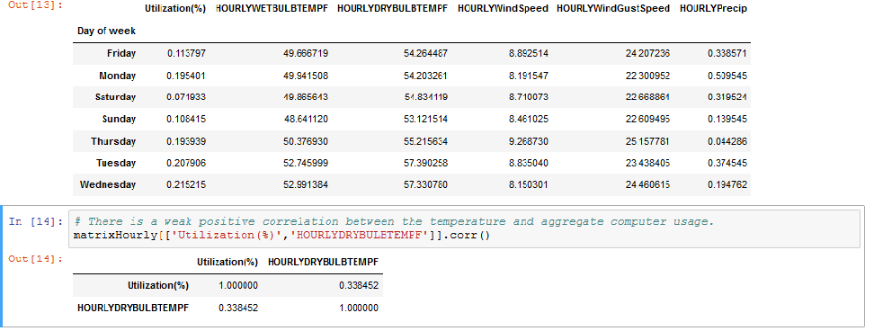
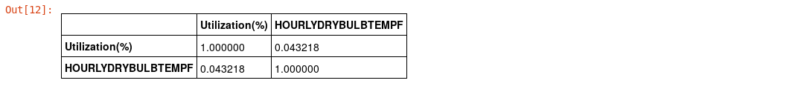
More on Utilization vs Temp
Six months of data
Seven year’s of data

Slide 10
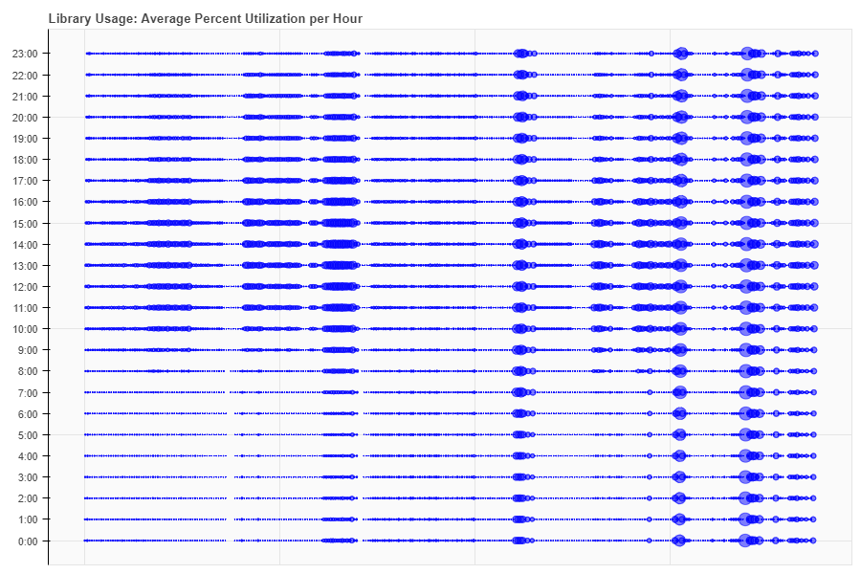
Average Usage per Hour

Slide 11
Future Goals
Nick: Hypothesis testing
Brown: Bokeh interactive graphs
Patti: Presentation.docx -explanation of each process
Michael: Visualization of Weather codes

